Slide 1
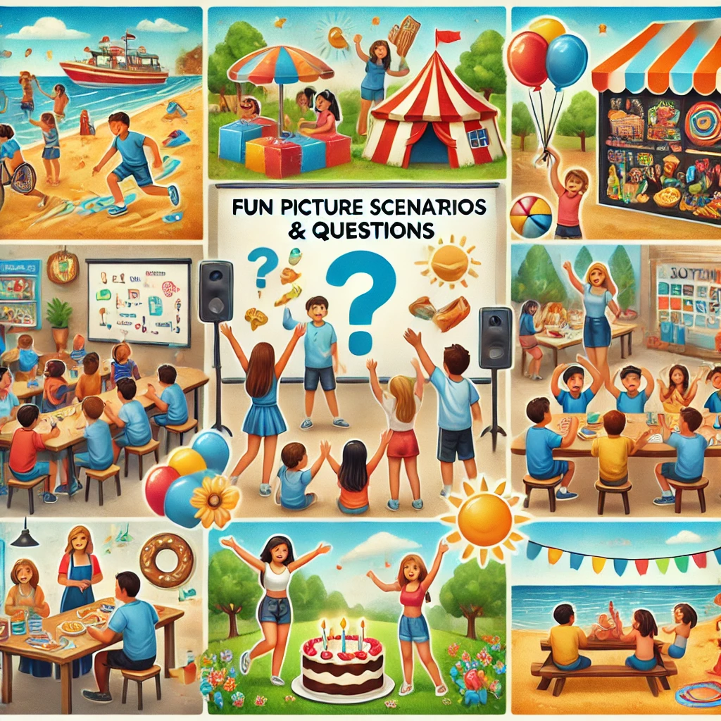
Fun picture scenarios and questions

Slide 2
Credits and terms of use
Thank You for Using This Resource!
This interactive PowerPoint was created to support speech and language development by teaching the concepts of before and after in a fun and engaging way. It is designed for speech and language therapists, educators, and parents working with young children.
Terms of Use
By downloading and using this resource, you agree to the following terms:
✅ Personal & Professional Use – This resource is intended for personal, educational, and therapeutic use only. You may use it in therapy sessions, classrooms, and home settings.
✅ Modification for Personal Use – You may adapt this resource for your own therapy or teaching sessions, but do not distribute modified versions.
✅ Attribution – If sharing elements from this resource (e.g., in a training or blog post), please credit the creator appropriately.
🚫 No Commercial Use – This resource may not be sold, copied, or distributed for commercial purposes.
🚫 No Unauthorized Sharing – Please do not upload this resource to public websites, social media, or file-sharing platforms. Instead, direct others to the original source.
Credits:
Created By: Aisha Hanif/ https://www.littlegemsspeechtherapy.com/
Illustrations & Images: AI-generated
For any questions, feedback, or permissions beyond these terms, please contact: littlegemsspeechtherapy@gmail.com
Thank you for respecting these terms and supporting ethical resource sharing!

Slide 3
Directions for Use
This interactive PowerPoint is designed for use in both family and school settings. It encourages children to develop their thinking and language skills by answering questions at different difficulty levels. Here’s how you can use it:
Choose a Picture Scene – Click on a scene to explore different real-life situations.
Answer the Questions – Each scene has questions at four levels. Start with level 1 and progress to level 4 as the child’s confidence grows.
Encourage Discussion – Let children explain their answers in their own words and ask follow-up questions to expand their thinking.
Use in Groups or Individually – This resource works well for one-on-one practice, small group activities, or whole-class discussions.
Make It Fun! – Praise responses, encourage creativity, and make the experience enjoyable for the child.

Slide 4
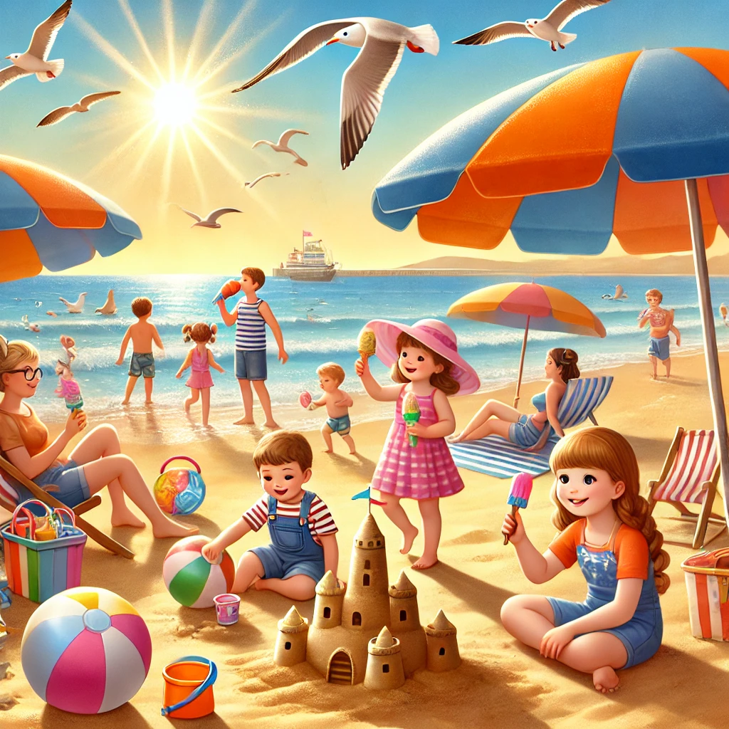

Slide 5
Level 1 (Naming/Pointing)
What is this? (Pointing to a sandcastle) → A sandcastle.
Where is the ball? → On the sand/in the air/in the water.
Who is wearing a sunhat? → The girl/boy near the umbrella.
What colour is the umbrella? → Red, blue, yellow, etc. (depending on the image).
Show me the waves. → (Child points to the waves in the image.)
Where is the ice cream? → In the child's hand/on the table.

Slide 6
Level 2 (Describing)
What is the boy doing with the bucket? → He is filling it with sand to make a sandcastle.
How does the water feel? → It feels cold, wet, and refreshing.
What do people wear at the beach? → Swimsuits, shorts, t-shirts, sunhats, and sunglasses.
Describe the sandcastle. → It is big, made of sand, has towers, and a small moat around it.
What is the weather like? → It is sunny and warm with a clear blue sky.
What do you see in the sky? → The sun, some clouds, and seagulls flying.

Slide 7
Level 3 (Storytelling & Predicting)
What might happen if a big wave comes? → It could wash away the sandcastle and make people run away.
How do you think the children feel? → They feel happy and excited to play at the beach.
What do you think will happen next? → The children will finish the sandcastle or go for a swim.
What could the family eat for lunch? → Sandwiches, fruit, crisps, and juice.
Why is the girl wearing sunglasses? → To protect her eyes from the bright sun.
How do you think the sandcastle was made? → The children used buckets and shovels to shape the sand.

Slide 8
Level 4 (Reasoning & Problem-Solving)
Why do people put on sunscreen? → To protect their skin from sunburn.
What would happen if someone forgot their towel? → They might have to sit on the sand and could get wet.
Why is it important to stay near an adult at the beach? → To stay safe in the water and not get lost.
What could you do if your ice cream melted? → Eat it quickly or get another one.
Why do waves move towards the shore? → Because of the wind and the movement of the ocean.
How could you make a stronger sandcastle? → Use wet sand, pack it tightly, and build walls around it.

Slide 9
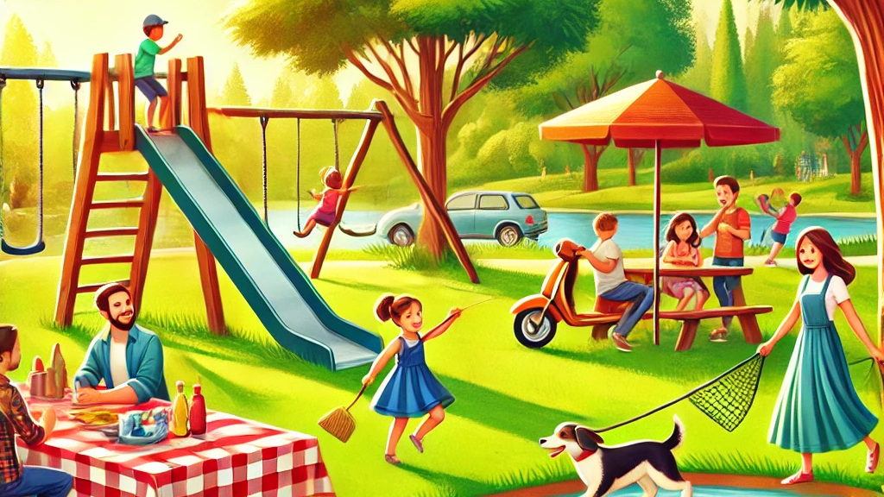

Slide 10
Level 1 (Naming/Pointing)
What is this? (Pointing to a swing) → A swing.
Where is the dog? → Running on the grass.
Who is sitting on the picnic blanket? → A family having a picnic.
What color is the slide? → Red, blue, green, etc.
Show me the pond. → (Child points to the pond in the image.)
Where are the ducks? → In the pond.

Slide 11
Level 2 (Describing)
What is the boy doing on the swing? → He is swinging back and forth.
How does the grass feel? → It feels soft and a little tickly.
What do people bring to a picnic? → Sandwiches, drinks, fruit, and a picnic blanket.
Describe the trees in the park. → They are tall, green, and provide shade.
What is the weather like? → It is sunny and warm with a cool breeze.
What do you see in the sky? → The sun, some clouds, and birds flying

Slide 12
Level 3 (Storytelling & Predicting)
What might happen if the ball rolls into the pond? → Someone might have to fetch it, or the ducks might play with it.
How do you think the children feel? → They feel happy and excited to play outside.
What do you think will happen next? → The children will take turns on the swings or play tag.
What could the family eat for their picnic? → Sandwiches, fruit, crisps, and juice.
Why is the child holding a leash for the dog? → To keep the dog safe and prevent it from running away.
How do you think the playground was made? → Builders used materials like wood and metal to create the swings and slides.

Slide 13
Level 4 (Reasoning & Problem-Solving)
Why do people go to the park? → To play, relax, and enjoy nature.
What would happen if someone forgot their picnic basket? → They might have to go home or buy food from a shop.
Why is it important to keep the park clean? → So everyone can enjoy it and to protect animals from litter.
What could you do if the swing was broken? → Tell an adult or park staff so they can fix it.
Why do ducks swim in the pond? → Because they live in the water and find food there.
How could you make the playground safer? → Check for broken equipment and make sure children take turns playing.

Slide 14
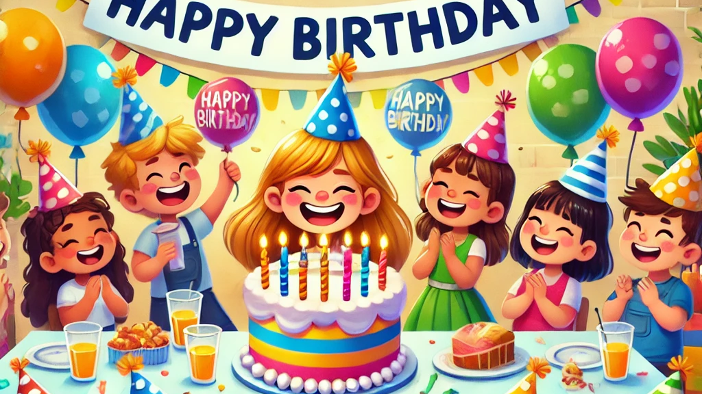

Slide 15
Level 1 (Naming/Pointing)
  What is this? (Pointing to a cake) → A cake.
  Where are the balloons? → Floating above the table.
  Who is wearing a party hat? → The birthday child/friends.
  What color is the birthday cake? → Pink, blue, yellow, etc. (depending on the image).
  Show me the candles. → (Child points to the candles on the cake.)
  Where are the presents? → On the table.

Slide 16
Level 2 (Describing)
What is the birthday child doing? → Blowing out the candles.
How does the cake taste? → Sweet, soft, and delicious.
What do people do at a birthday party? → Eat cake, play games, open presents.
Describe the balloons. → They are colorful, floating, and tied with strings.
What is on the birthday table? → Cake, presents, plates, drinks, and snacks.
What do children wear at parties? → Party hats, fancy clothes, and sometimes costumes.

Slide 17
Level 3 (Storytelling & Predicting)
What might happen after the candles are blown out? → The child will cut the cake and share it.
How do you think the birthday child feels? → Happy, excited, and surprised.
What do you think will happen next? → The children will play games or open presents.
What could be inside the presents? → Toys, books, clothes, or surprises.
Why are the children smiling? → Because they are having fun.
How do you think the party was planned? → The parents decorated, made food, and invited friends.

Slide 18
Level 4 (Reasoning & Problem-Solving)
Why do we celebrate birthdays? → To mark another year of life and spend time with loved ones.
What would happen if there was no cake? → The children might feel disappointed, but they could eat other treats.
Why do we blow out candles? → It is a tradition to make a wish.
What could you do if a balloon popped? → Get a new one or continue the party.
Why do people give presents at birthdays? → To show love and make the birthday person happy.
How could you make the party more fun? → Play games, have music, and invite more friends.

Slide 19
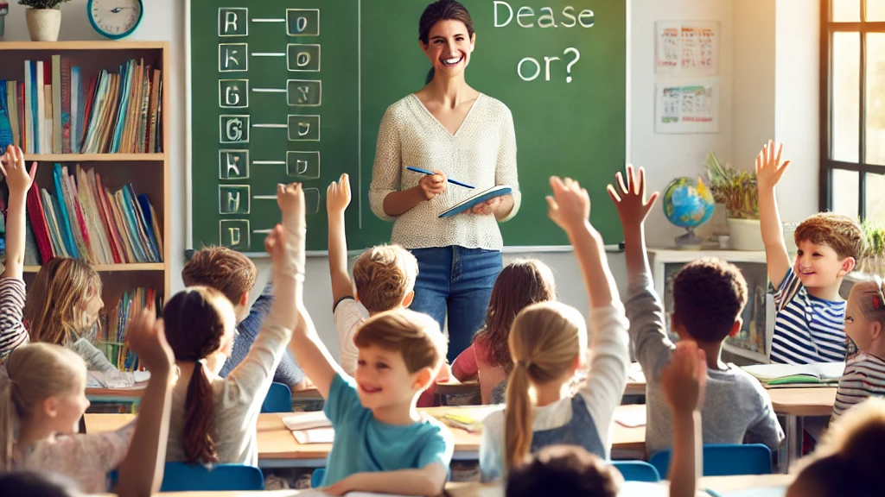

Slide 20
Level 1 (Naming/Pointing)
What is this? (Pointing to a pencil) → A pencil.
Where is the teacher? → At the front of the classroom.
Who is raising their hand? → The students.
What color is the chalkboard? → Green/black (depending on image).
Show me the books. → (Child points to books).
Where are the students sitting? → At their desks.

Slide 21
Level 2 (Describing)
What is the teacher doing? → Writing on the board and teaching.
How do students show they want to answer? → They raise their hands.
What do people use to write? → A pencil or a pen.
Describe the classroom. → It has desks, a board, books, and students learning.
What do students do in class? → They listen, write, and answer questions.
What is on the teacher’s desk? → Papers, books, and a cup with pencils.

Slide 22
Level 3 (Storytelling & Predicting)
What might happen after the teacher asks a question? → A student will answer.
How do you think the students feel? → Focused, excited, or curious.
What do you think will happen next? → The teacher will explain more or call on a student.
What could happen if no one listens? → The teacher might have to remind them to focus.
Why do you think students are raising their hands? → They want to answer or ask a question.
What could happen if someone forgets their book? → They might need to share with a friend.

Slide 23
Level 4 (Reasoning & Problem-Solving)
Why do students go to school? → To learn new things and make friends.
What would happen if no one did their homework? → They might not understand the lesson.
Why does the teacher write on the board? → To help students see and understand.
What could you do if you don’t understand something? → Ask the teacher or a friend for help.
Why do students take turns speaking? → So everyone gets a chance and it's not too noisy.
How can students be good learners? → By listening, asking questions, and practicing.

Slide 24
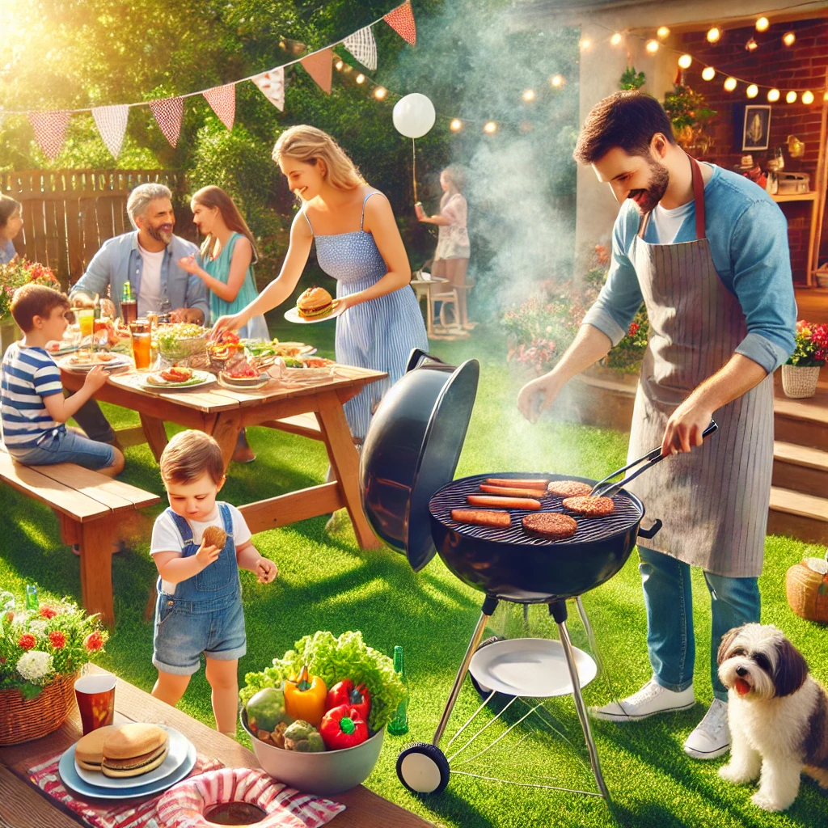

Slide 25
Level 1 (Naming/Pointing)
What is the dad doing? → The dad is grilling food.
What is on the table? → Plates, cups, and salad are on the table.
What are the children playing with? → The children are playing with a ball.
Who is bringing the tray? → A child is bringing the tray.
What colour are the decorations? → The decorations are colorful.
Where is the dog? → The dog is sitting nearby.

Slide 26
Level 2 (Describing)
What food is being grilled? → Burgers and hot dogs are being grilled.
Why do people have barbecues? → People have barbecues to enjoy food and time together.
What might happen next? → They might start eating soon.
How do you think the family feels? → The family looks happy and excited.
What do you like to eat at a barbecue? → (Personal answer: e.g., "I like burgers.")
Where might this barbecue be taking place? → The barbecue might be in a backyard or park.

Slide 27
Level 3 (Storytelling & Predicting)
What do you need to have a barbecue? → You need a grill, food, and plates.
Why do people eat outside when barbecuing? → People eat outside because it is fun and fresh.
What could go wrong at a barbecue? → Food could burn, or the weather could change.
Why do you think the child is helping? → The child is helping to be useful and learn.
How does grilling food change it? → Grilling makes food hot and gives it a smoky taste.
What would happen if it started to rain? → They might have to move inside or stop grilling.

Slide 28
Level 4 (Reasoning & Problem-Solving)
What are the benefits of cooking food on a barbecue? → Barbecuing makes food taste good and can be healthier.
How do barbecues bring people together? → People talk, eat, and have fun together at barbecues.
What safety rules should be followed at a barbecue? → Keep the fire controlled, don’t touch the grill, and be careful.
How do different cultures barbecue food differently? → Some cultures use different spices, meats, and cooking styles.
What might the family do after they finish eating? → They might clean up, play games, or relax.
How is a barbecue different from cooking in the kitchen? → Barbecuing uses fire outside, while kitchens use stoves and ovens.

