Slide 1
Before/after

Slide 2
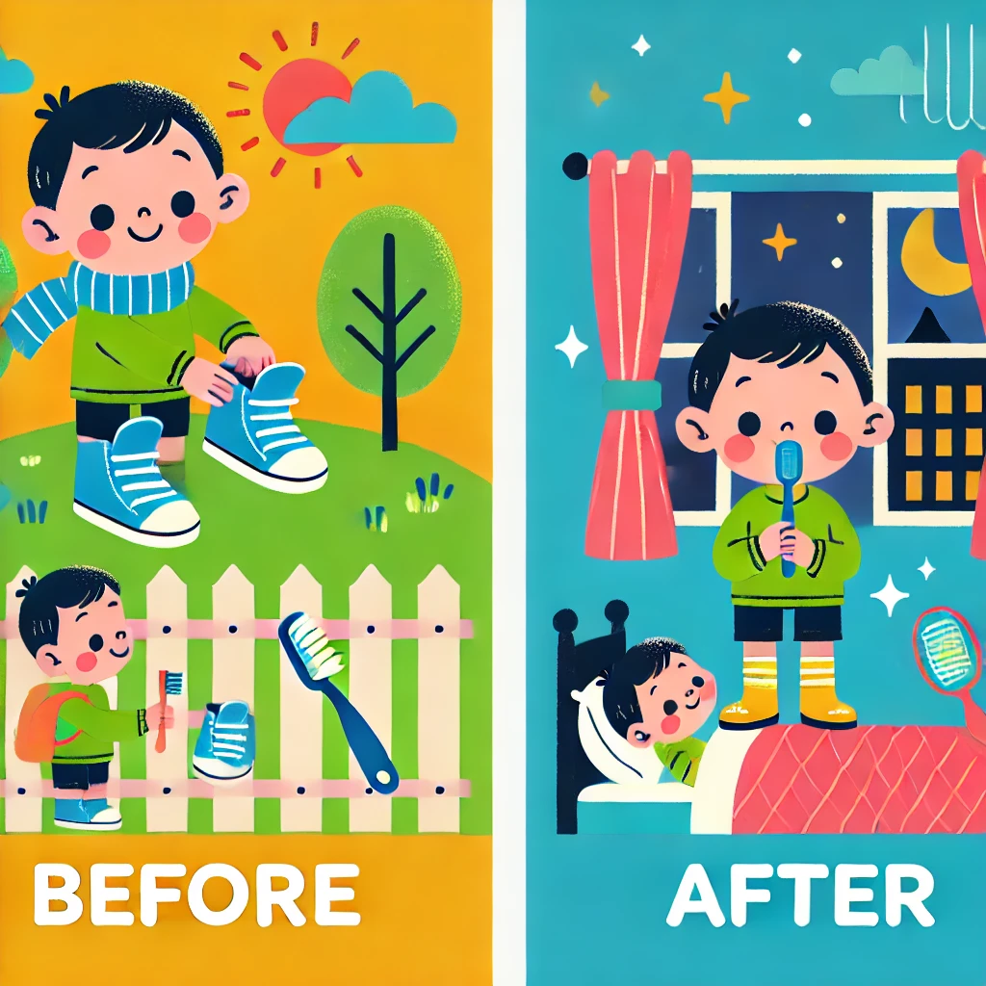
Before & After: An Interactive Speech & Language Resource
Helping Children Understand Sequencing & Time Concepts
Created by Aisha Hanif at Little Gems Speech Therapy
Designed for Parents, Educators & Speech Therapists
Visual Representation: A bright, engaging image illustrating the concept of "before and after," such as a child putting on shoes before going outside or brushing teeth before bed.
Purpose: This interactive resource supports children in understanding the concepts of "before" and "after" through engaging activities and real-life scenarios.
How to Use: Navigate through the slides, discuss each scenario with the child, and encourage them to apply the concepts in daily routines.
Let's Make Learning Fun & Meaningful!

Slide 3
  Credits & Terms of Use
Thank You for Using This Resource!
This interactive PowerPoint was created to support speech and language development by teaching the concepts of before and after in a fun and engaging way. It is designed for speech and language therapists, educators, and parents working with young children.
Terms of Use
By downloading and using this resource, you agree to the following terms:
✅ Personal & Professional Use – This resource is intended for personal, educational, and therapeutic use only. You may use it in therapy sessions, classrooms, and home settings.
✅ Modification for Personal Use – You may adapt this resource for your own therapy or teaching sessions, but do not distribute modified versions.
✅ Attribution – If sharing elements from this resource (e.g., in a training or blog post), please credit the creator appropriately.
🚫 No Commercial Use – This resource may not be sold, copied, or distributed for commercial purposes.
🚫 No Unauthorized Sharing – Please do not upload this resource to public websites, social media, or file-sharing platforms. Instead, direct others to the original source.
Credits:
Created By: Aisha Hanif/ www.littlegemsspeechtherapy.com
Illustrations & Images: AI-generated
For any questions, feedback, or permissions beyond these terms, please contact: littlegemsspeechtherapy@gmail.com
Thank you for respecting these terms and supporting ethical resource sharing!

Slide 4
Directions for Use
This interactive PowerPoint is designed to help children develop an understanding of the concepts before and after in a fun and engaging way. It is suitable for parents, educators, and speech and language therapists working with young children.
Instructions:
Introduce the Concept – Start by explaining what "before" and "after" mean using simple examples.
Use the Slides Interactively – Click through the slides, encouraging the child to think, respond, and engage with each scenario.
Encourage Verbal Responses – Ask questions like:
  "What do we do before we eat?"
  "What happens after we wash our hands?"
Model Correct Language – If the child struggles, provide the correct answer and repeat it together.
Make It Fun – Use gestures, role-play, and real-life examples to reinforce learning.
Practice Daily – Encourage using "before" and "after" in everyday conversations to strengthen understanding.
Tips for Best Results:
✔ Keep sessions short and engaging.
✔ Praise efforts to encourage participation.
✔ Adapt the level of support based on the child’s needs.

Slide 5

after
before
We eat dessert dinner

Slide 6
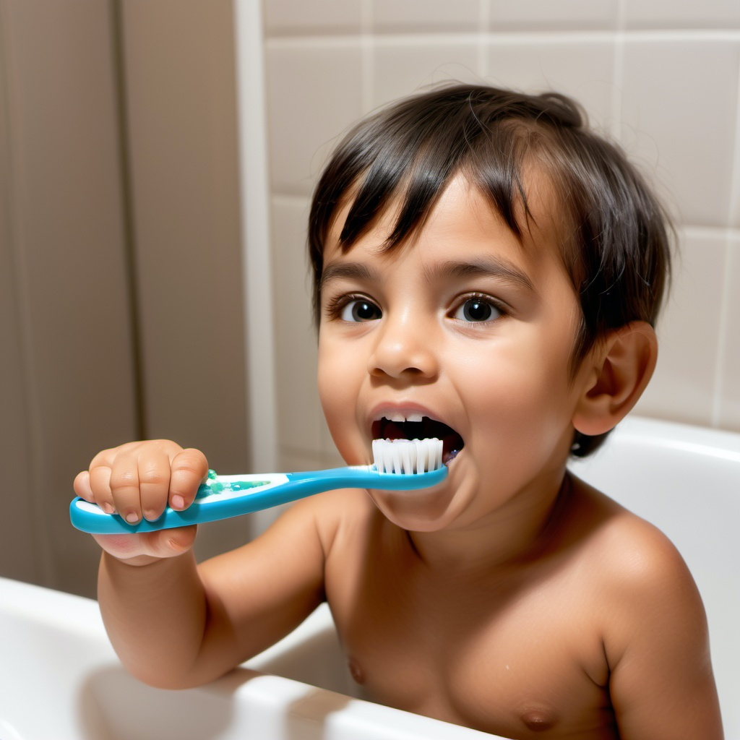
after
before
Brush your teeth going to bed.

Slide 7

after
before
Put your shoes on you play outside.

Slide 8
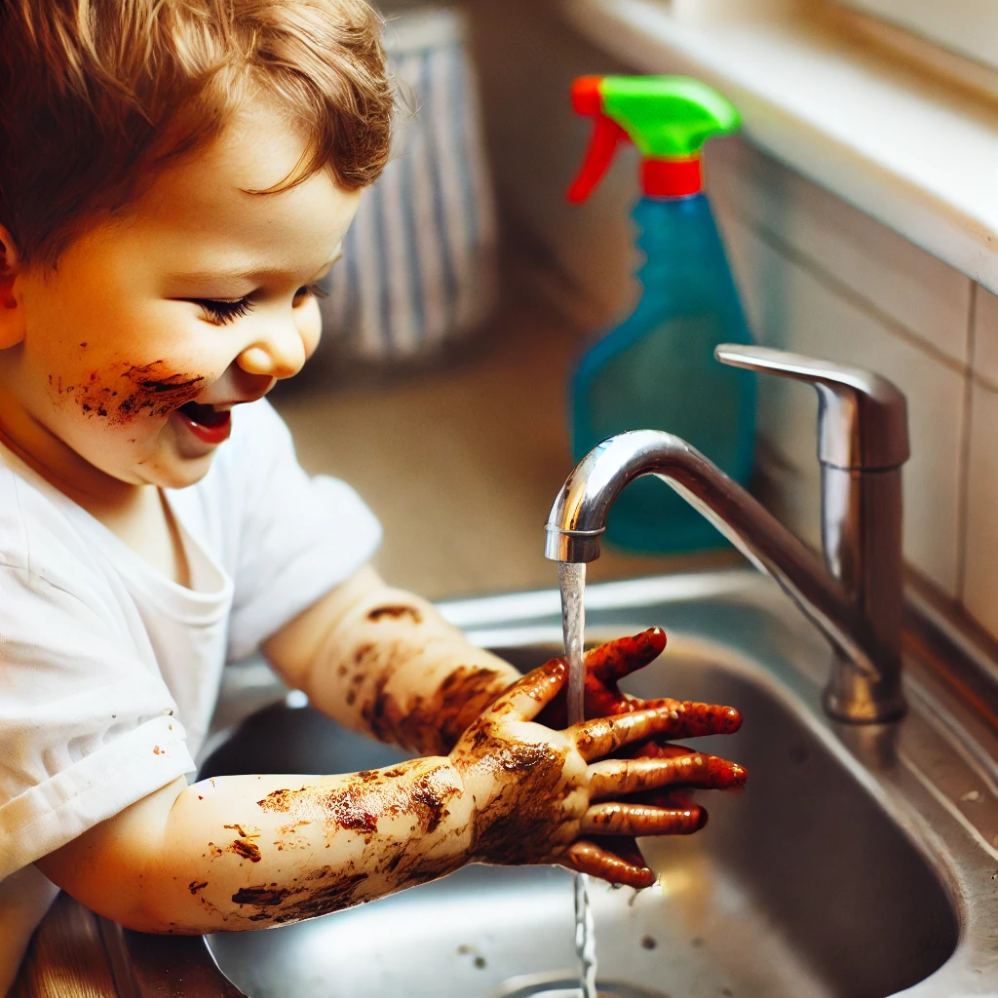
after
before
Wash your hands playing with dirt.

Slide 9

after
before
Read a book going to bed.

Slide 10
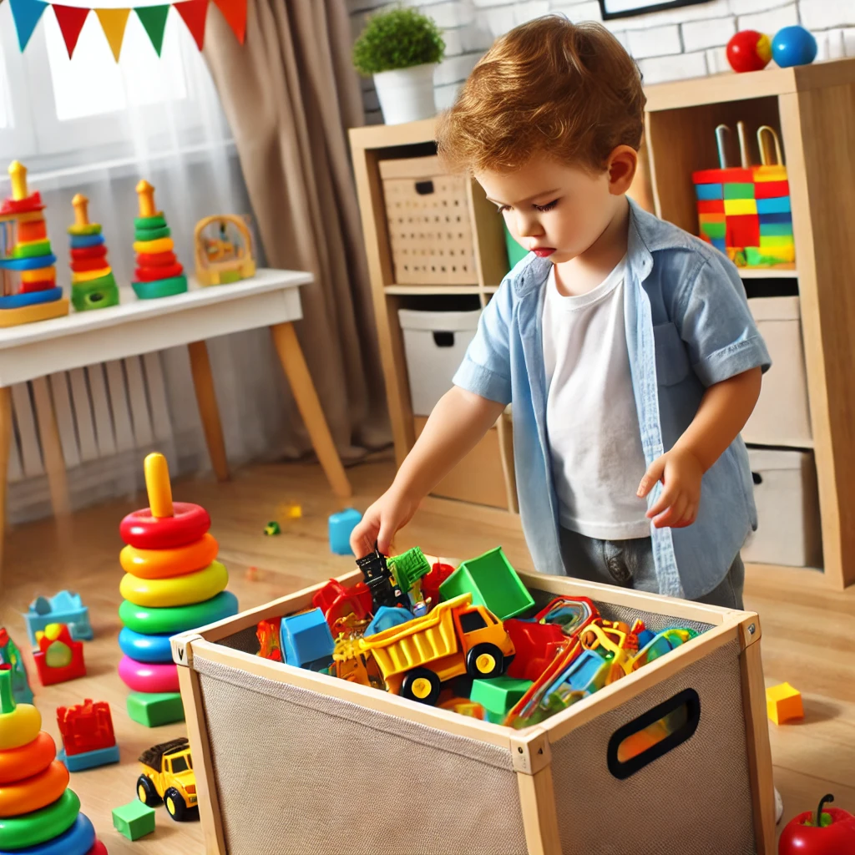
after
before
Tidy up playing a game.

Slide 11

after
before
Put your coat on you go outside.

Slide 12
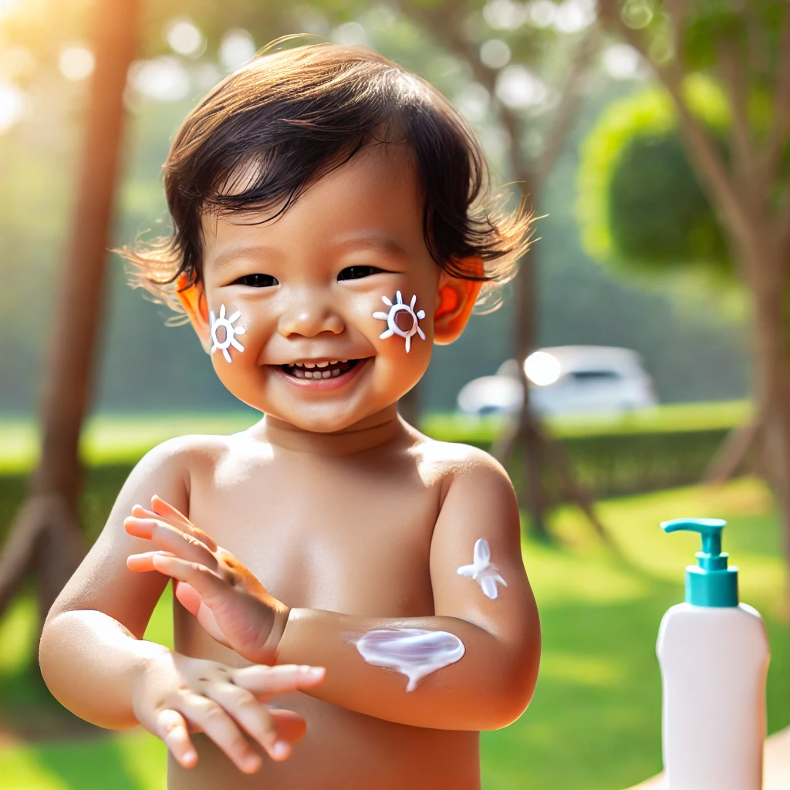
after
before
Put sunscreen on you go outside.

Slide 13
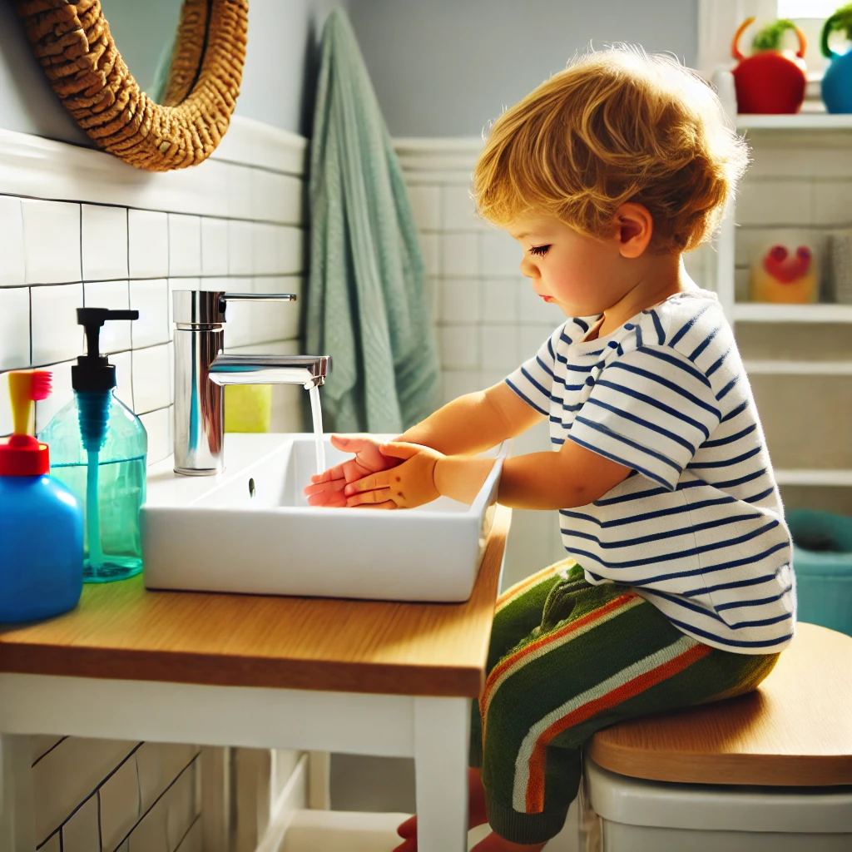
after
before
Wash your hands you use the toilet.

Slide 14
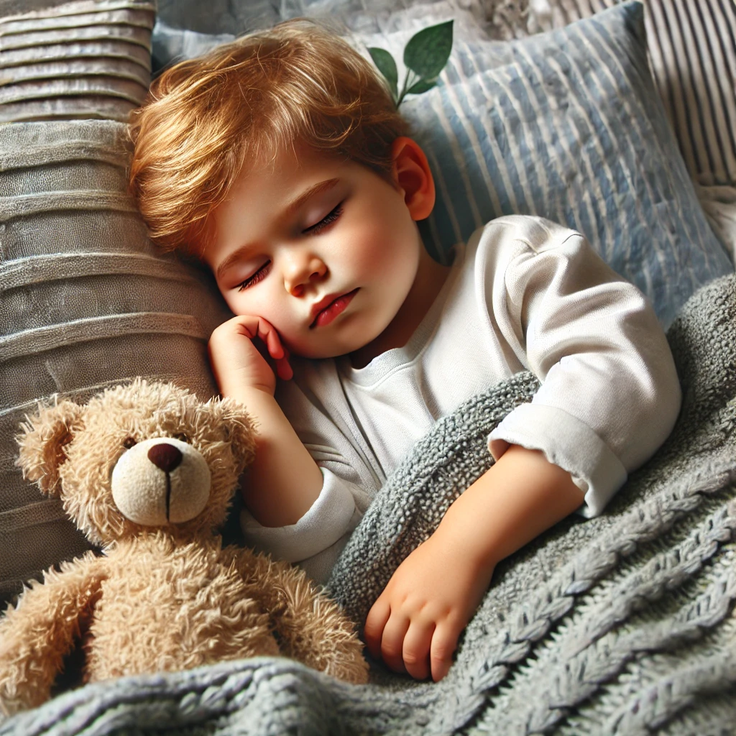
after
before
Hug your teddy going to sleep.

Slide 15

after
before
Give a hug saying good-bye.

Slide 16
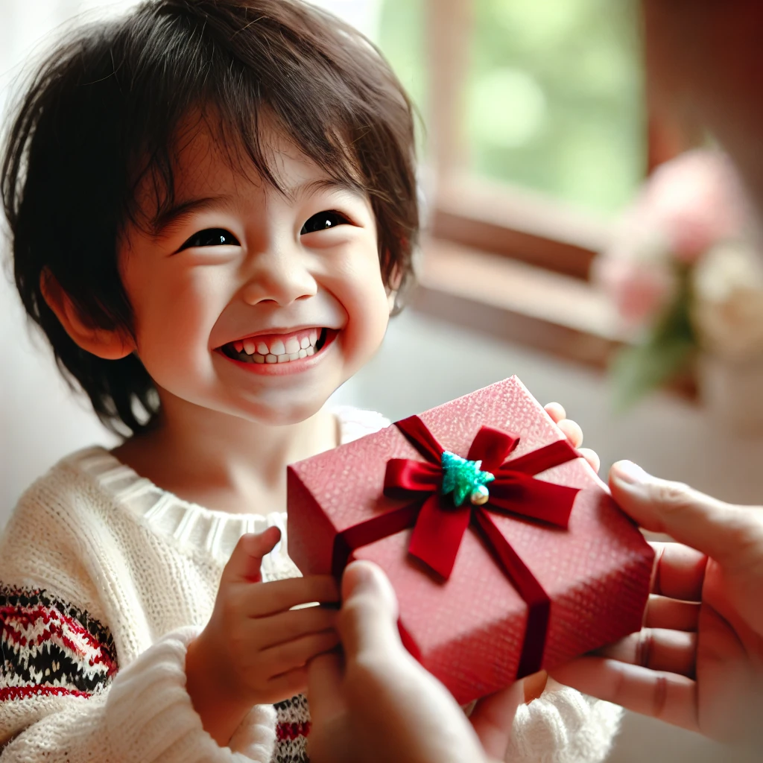
after
before
Say thank you receiving a gift.

Slide 17
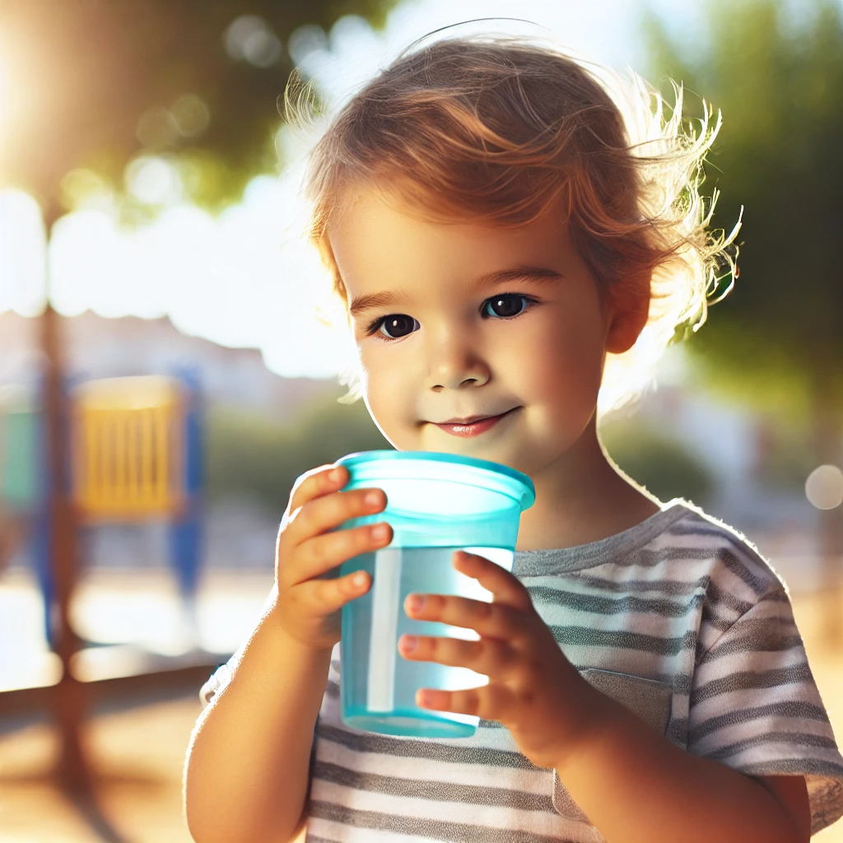
after
before
Cool down with a drink playing outside.

Slide 18
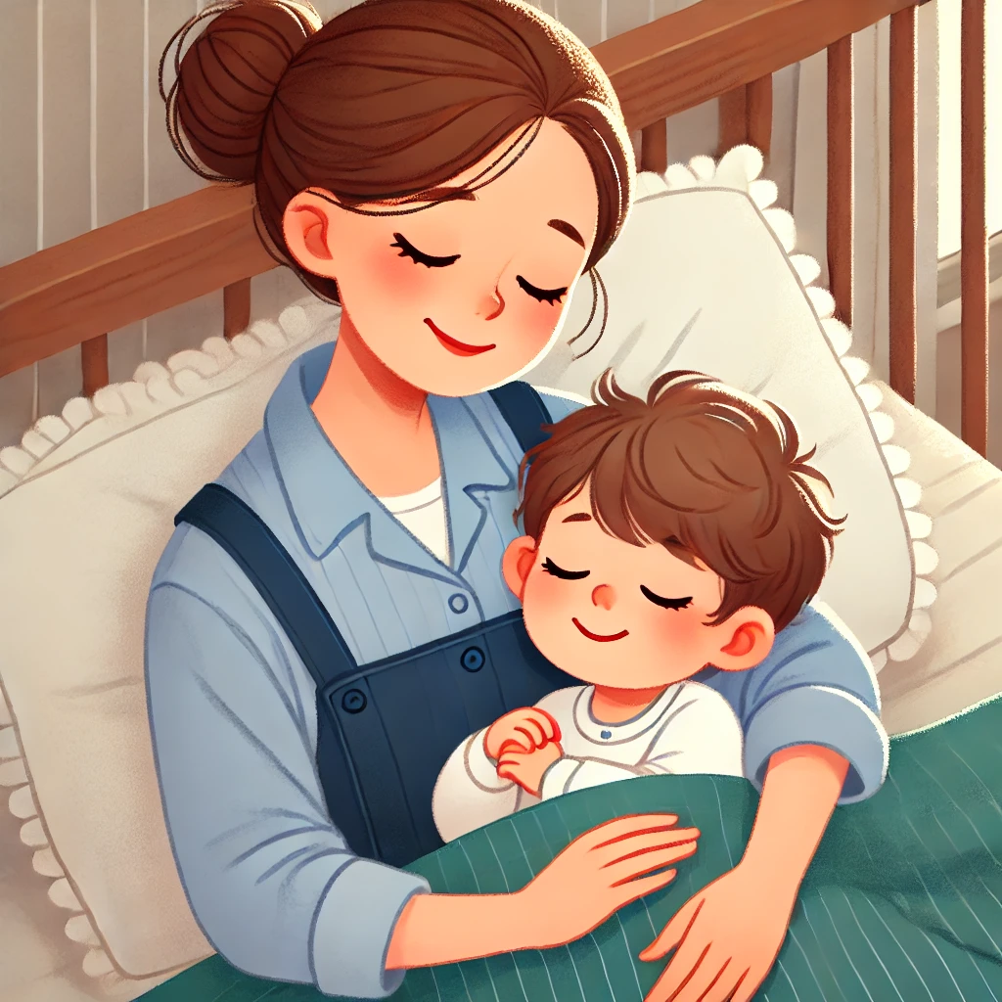
after
before
Mum sings a song going to sleep.

Slide 19
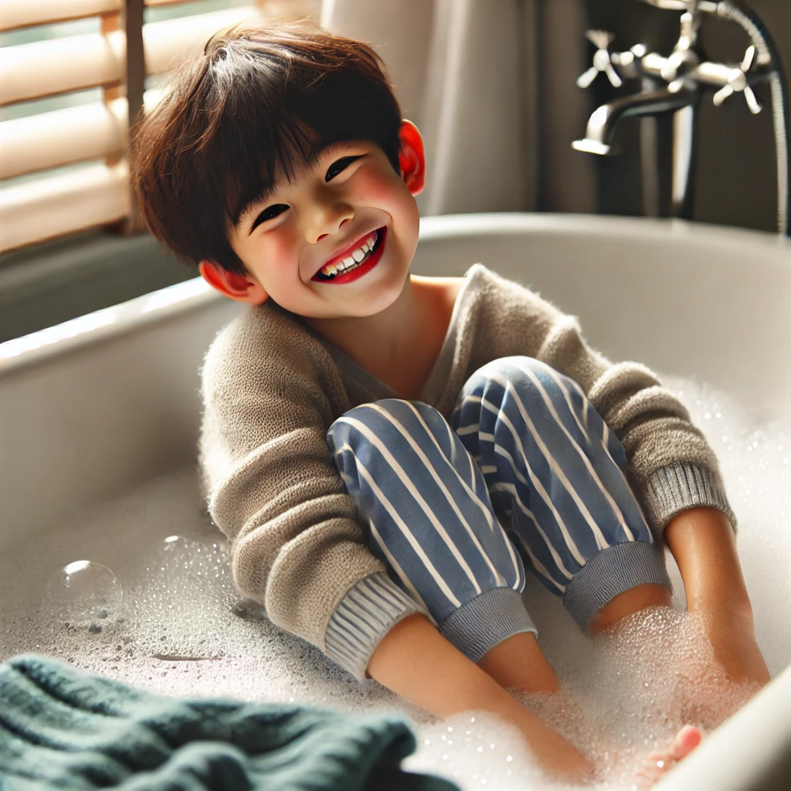
after
before
Take off your clothes going for a bath.

